Slide 1
Generate your own dataset
Sungjoon Choi
(sungjoon.choi@cpslab.snu.ac.kr)

Slide 2
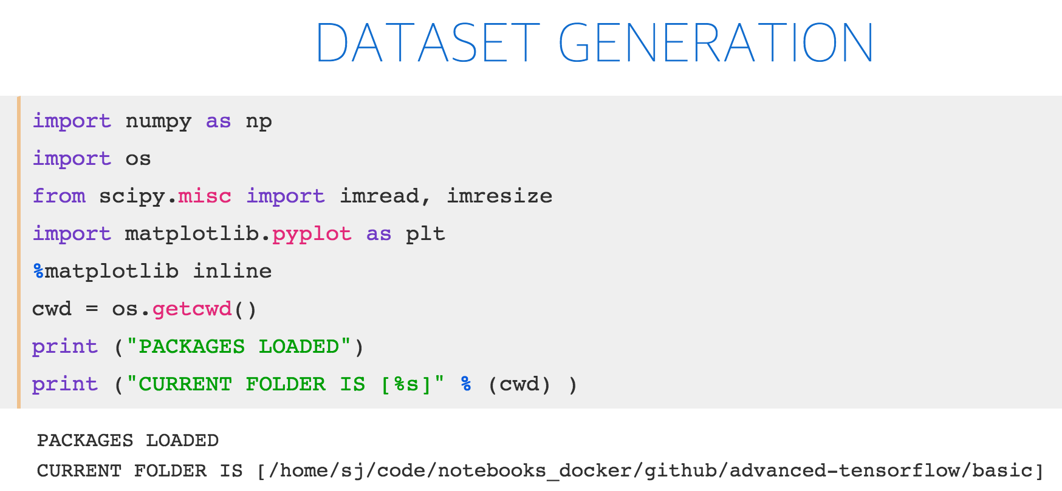
Notes:
import numpy as np
import tensor flow as tf
import matplotlib.pyplot as plt
from tensorflow.examples.tutorials.mnist
import input_data
%matplotlib inline print ("PACKAGES LOADED")

Slide 3
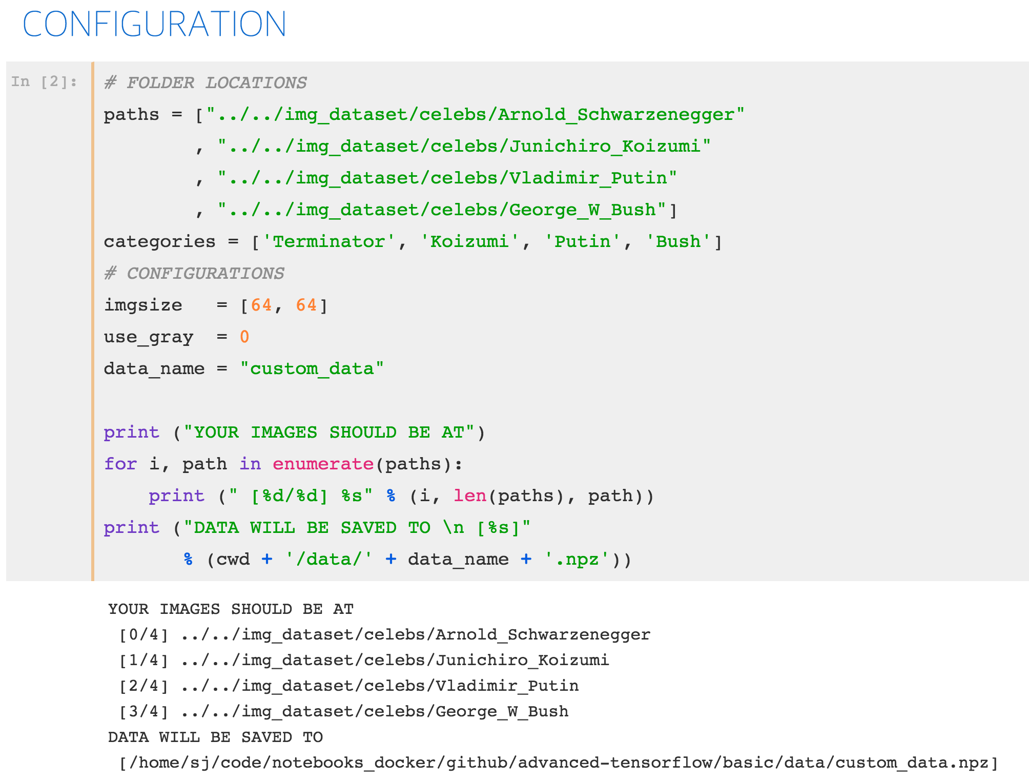
Notes:
import numpy as np
import tensor flow as tf
import matplotlib.pyplot as plt
from tensorflow.examples.tutorials.mnist
import input_data
%matplotlib inline print ("PACKAGES LOADED")

Slide 4
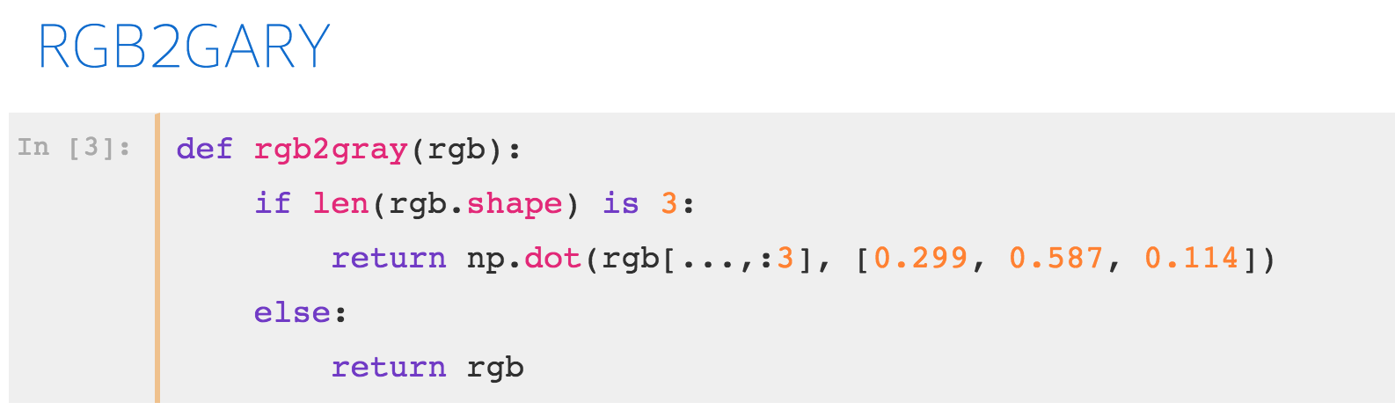
Notes:
import numpy as np
import tensor flow as tf
import matplotlib.pyplot as plt
from tensorflow.examples.tutorials.mnist
import input_data
%matplotlib inline print ("PACKAGES LOADED")

Slide 5
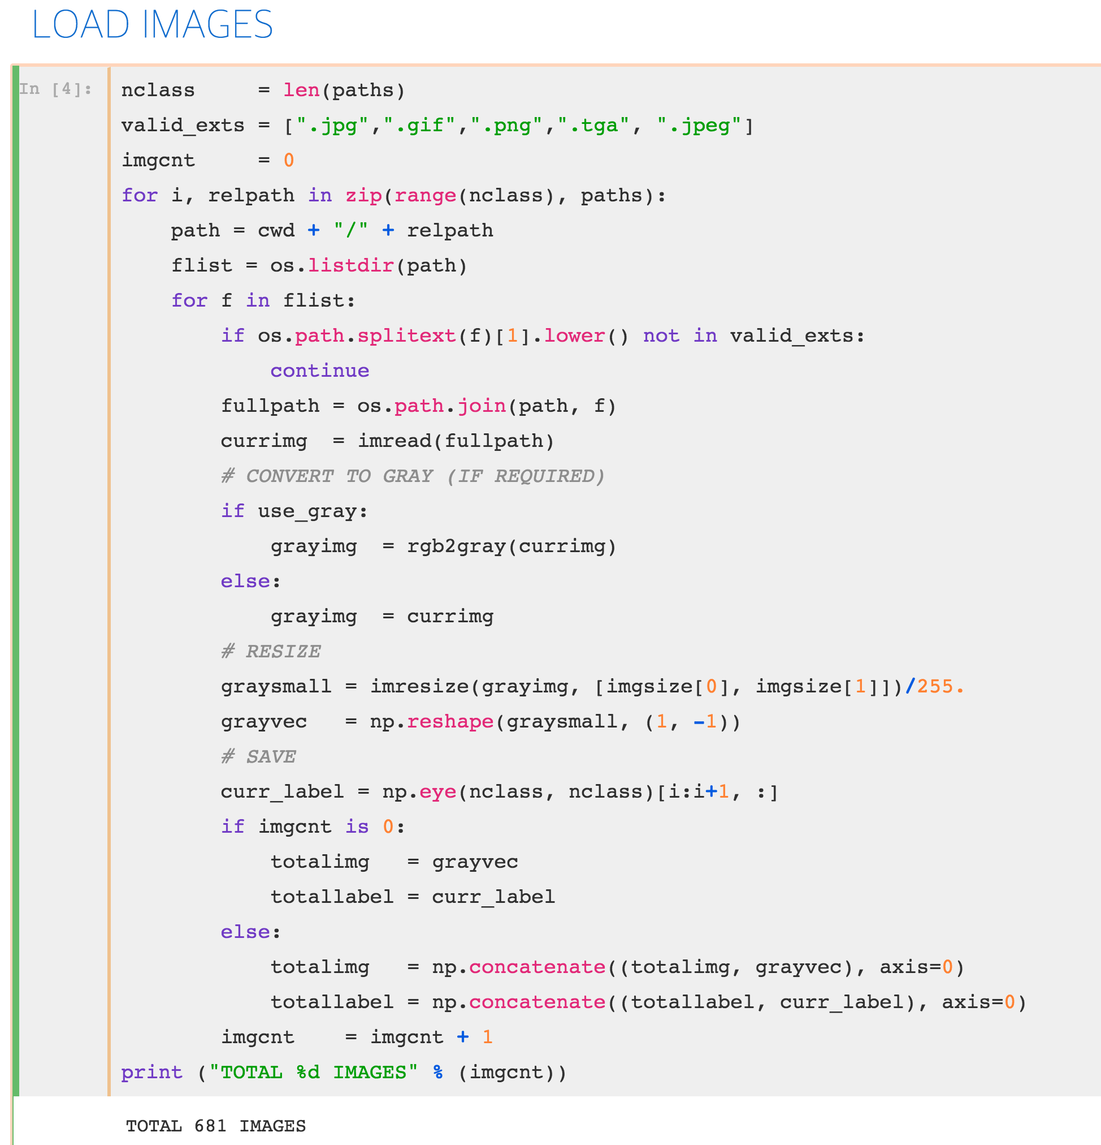
Notes:
import numpy as np
import tensor flow as tf
import matplotlib.pyplot as plt
from tensorflow.examples.tutorials.mnist
import input_data
%matplotlib inline print ("PACKAGES LOADED")

Slide 6
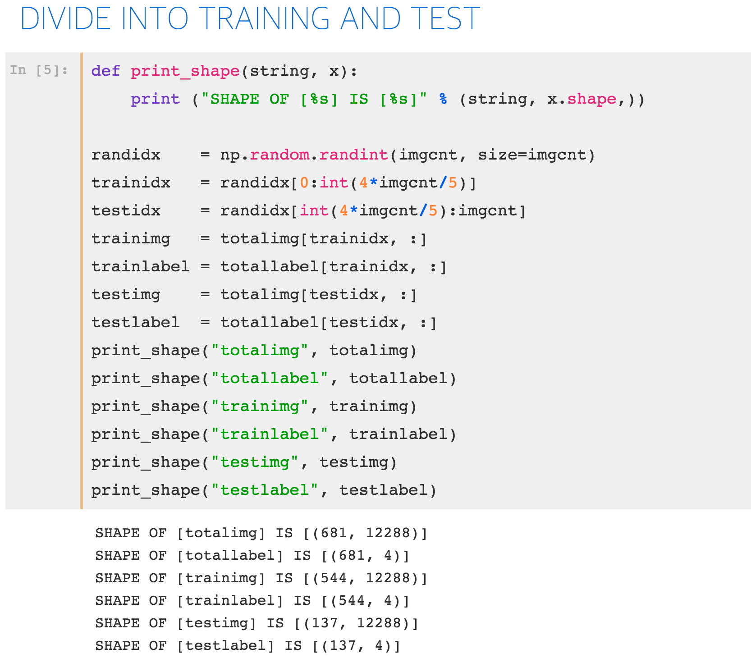
Notes:
import numpy as np
import tensor flow as tf
import matplotlib.pyplot as plt
from tensorflow.examples.tutorials.mnist
import input_data
%matplotlib inline print ("PACKAGES LOADED")

Slide 7
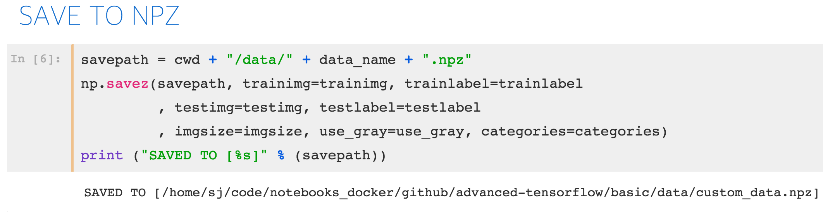
Notes:
import numpy as np
import tensor flow as tf
import matplotlib.pyplot as plt
from tensorflow.examples.tutorials.mnist
import input_data
%matplotlib inline print ("PACKAGES LOADED")

Slide 8
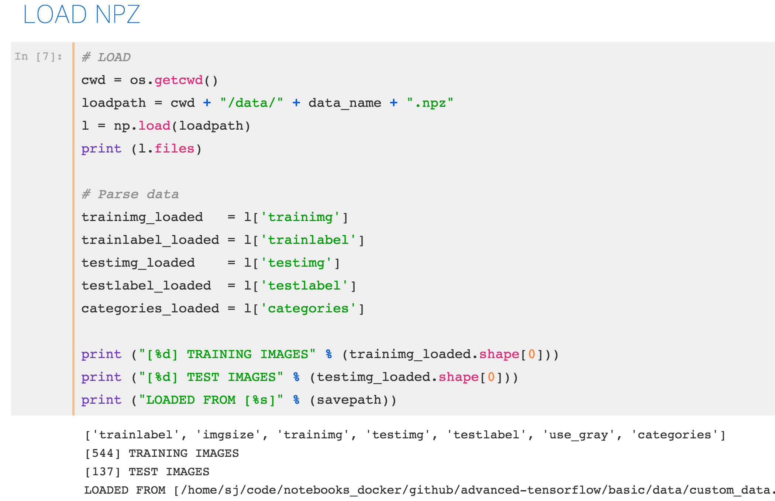
Notes:
import numpy as np
import tensor flow as tf
import matplotlib.pyplot as plt
from tensorflow.examples.tutorials.mnist
import input_data
%matplotlib inline print ("PACKAGES LOADED")

Slide 9
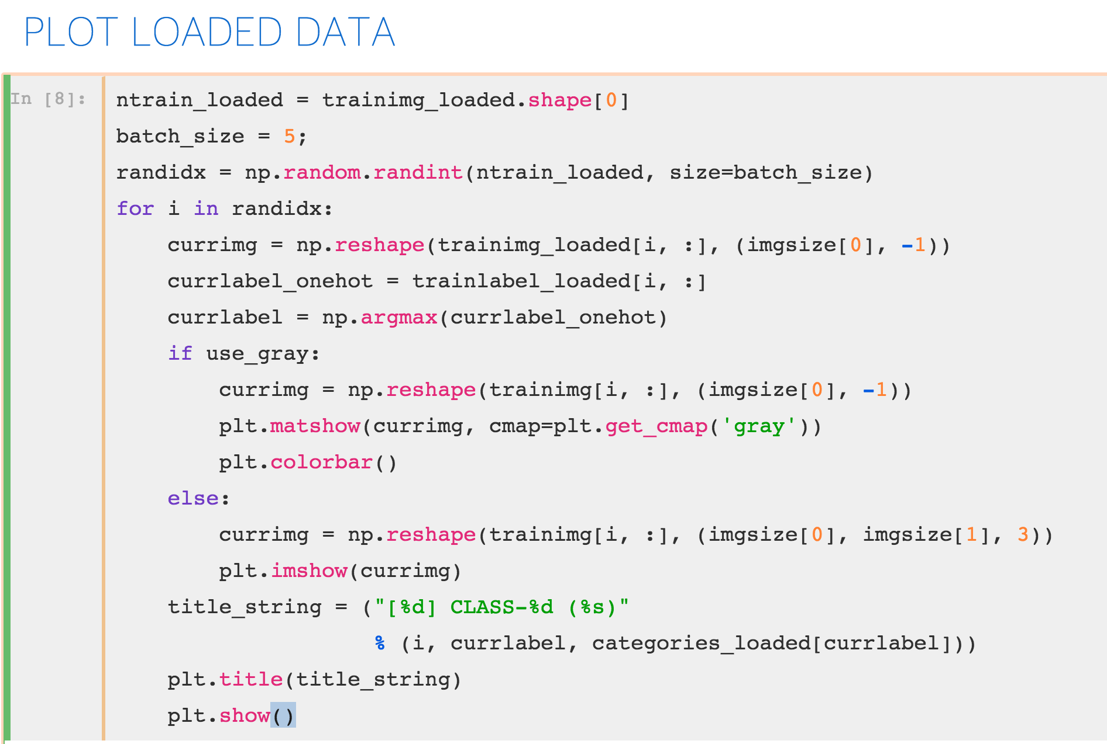
Notes:
import numpy as np
import tensor flow as tf
import matplotlib.pyplot as plt
from tensorflow.examples.tutorials.mnist
import input_data
%matplotlib inline print ("PACKAGES LOADED")

Slide 10
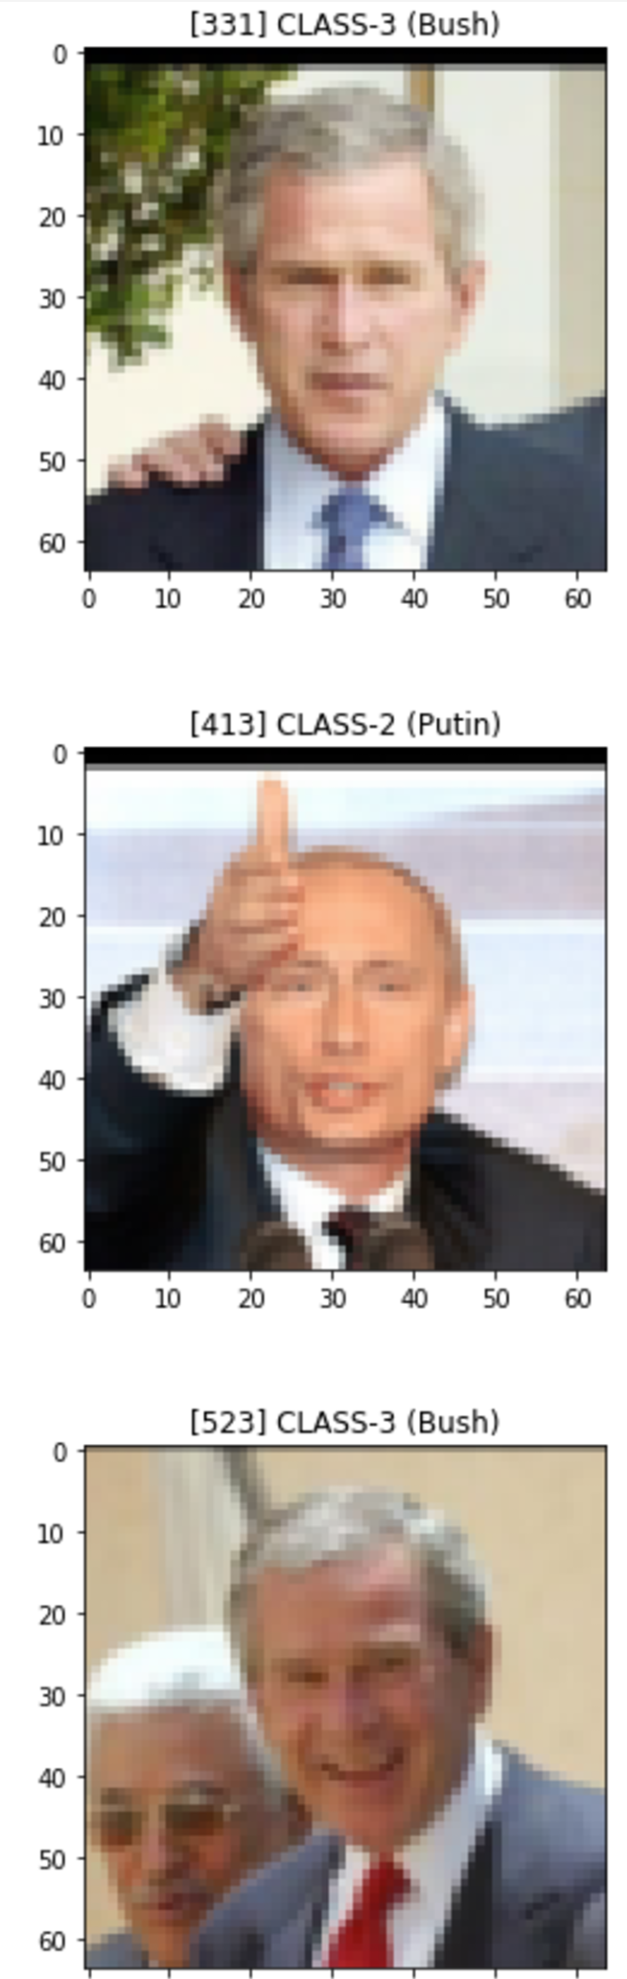
Notes:
import numpy as np
import tensor flow as tf
import matplotlib.pyplot as plt
from tensorflow.examples.tutorials.mnist
import input_data
%matplotlib inline print ("PACKAGES LOADED")

